Slide 1
Module 4
Trademarks: Eligibility Criteria. Who Can Apply for a Trademark. Acts and Laws. Designation of Trademark Symbols. Classification of Trademarks. Registration of a Trademark is Not Compulsory. Validity of Trademark. Types of Trademark Registered in India. Trademark Registry. Process for Trademarks Registration. Prior Art Search. Famous Case Law: Coca-Cola Company vs. Bisleri International Pvt. Ltd.

Slide 2

Trademark
A Trademark (or Trade Mark) is a unique symbol which is capable of identifying as well as differentiating products or services of one organization from those of others. The word ‘Mark‘ stands for a sign, design, phrase, slogan, symbol, name, numeral, devise, or a combination of these. Essentially, the Trademark is anything that identifies a brand to a common consumer.

Slide 3
Eligibility Criteria
For goods/services to be legally classified as Trademark, they need to pass the following conditions:
Distinctiveness - The goods and services for which the protection is sought should possess enough uniqueness to identify it as a Trademark. It must be capable of identifying the source of goods or services in the target market.
Descriptiveness - The Trademark should not be describing the description of the concerned goods or services. Descriptive marks are unlikely to be protected under Trademark law. However, descriptive words may be registered if they acquire secondary meaning, such as the brand name_Apple‘ is used by a USA based multinational company that manufactures electronic gadgets.
Similarity to the prior marks - The mark should be unique and should not be having similarity to the existing marks.

Slide 4

Who Can Apply for a Trademark
Any person who is a proprietor of the Trademark is eligible to apply for registration of Trademark.
The mark can be filed collectively by two or more applicants and for that purpose, support documents need to be submitted.
An organization or association can file for the collective mark and the same can be used by its members.
The most appropriate example for this mark is the
_Reliance‘ symbol, which indicates all products falling under the organization.

Slide 5
Acts and Laws
In India, Trademarks are governed under The Trademarks Act, 1999 https://ipindia.gov.in/writereaddata/Portal/IPOAct/1_43_1_trade-marks-act.pdf
The Trademark rules are governed by Trademarks Rules, 2002
https://ipindia.gov.in/writereaddata/Portal/IPORule/1_56_1_1_59_1_tmr_rules_2002_1_.pdf
The Acts and Rules have been amended from time to time. The latest amendments were done in 2010 and 2017 for Trademarks Acts and Trademarks, respectively. The administration of matters pertaining to Trademarks is carried out by the Office of Controller General of Patents, Designs, and Trade Marks (CGPDTM), GoI.

Slide 6
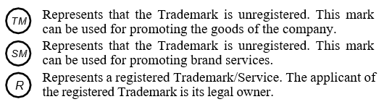
Designation of Trademark Symbols
Classification of Trademarks
Goods and Services under Trademarks are classified as per the ‘Nice Agreement’ (1957) administered by WIPO. A total of 149 countries (84 state parties who are signatory to the Agreement and 65 additional states who are following this classification for the Trademarks) and others (African Intellectual Property Organization, African Regional IP Organization and Trademark Office of European Union) are using the same Trademark classification.
Trademark classification comprises of 45 classes, out of which 34 are for goods and 11 are for services.
Two examples of the classes are: Class 1 and Class 45

Slide 7
Class 1 is for Chemicals for use in industry, science and photography, agriculture, horticulture and forestry; Unprocessed artificial resins, unprocessed plastics; Fire extinguishing and fire prevention compositions; Tempering and soldering preparations; Substances for tanning animal skins and hides; Adhesives for use in industry; Putties and other paste fillers; Compost, manures, fertilizers; Biological preparations for use in industry and science.
Class 45 is for legal services; Security services for the physical protection of tangible property and individuals; Personal and social services rendered by others to meet the individuals‘ needs.

Slide 8
Registration of a Trademark is Not Compulsory
Although, registration of a Trademark is not compulsory, registration provides certain advantages to the proprietor of the Trademark, such as:
Legal Protection – prevents the exploitation of the Registering Trademark by other companies/organizations/individuals, without proper authorization by the legal owner/s of the Trademark. In case of legal suits, a registered Trademark can serve as a potent evidence of the lawful proprietorship of the Trademark.
Exclusive Right - grants the Trademark owner full rights to use it in any lawful manner to promote his business.
Brand Recognition - products/ services are identified by their logo, which helps create brand value over time. A strong brand is a huge pull for new customers and an anchor for existing customers. Registering a Trademark early and using it will create goodwill and generate more business for the brand owner.
Asset Creation - registered Trademark is an intangible property of the organization. It can be used for enhancing the business of the company as well as drawing new clients and retaining old one by the account of brand identification.

Slide 9
Validity of Trademark
In India, a registered Trademark is valid for 10 years. The period can be extended every 10 years, perpetually. As per the Indian Trademarks Act, the renewal request is to be filed in the form ‘TM-R‘ within one year before the expiry of the last registration of the mark.

Slide 10
Types of Trademark Registered in India
Trademark can be a word that must be able to speak, spell and remember.
One should choose the Trademark like invented word, created words, and unique geographical name.
One should refrain from Trademarks like common geographical name, common personal name and the praising words which describe the quality of goods, such as best, perfect, super, etc.
It is suggested to conduct a market survey to ensure if a similar mark is used in the market.

Slide 11
Following are some examples of the registerable Trademarks:
Any name including personal or surname of the applicant or predecessor in business or the signature of the person e.g. the Trademark ‘BAJAJ’ is named after industrialist Mr. Jamnalal Bajaj.
A word having no relevance to the product/services e.g. Trademark ‘INDIA GATE‘ is being used for food grains and allied products.
Letters or numerals or any combination thereof e.g. ‘YAHOO’ is the abbreviation of the phrase “Yet Another Hierarchical Officious Oracle” It has now become a worldwide famous Trademark.

Slide 12
Some of the famous examples of Trademarks.
S. No. | Type of the Mark | Mark | Company/Firm
1. | Distinctive General Word | ‘Apple’ | IT Company
2. | Fanciful Designation | ‘Kodak’ | Photograph Film
3. | Distinctive Personal Names | ‘Ford’ | Automotive
4. | Device | ‘Udhaar’ | Financial Technology
5. | Number | ‘4711’ | Perfume
6. | Picture | Allegator | Knitwear Manufacturing
7. | Slogan | Drink it to believe it | Soft Drinks

Slide 13
Trademark Registry
In India, the operations of Trademarks are carried out from five cities i.e. Delhi, Mumbai, Ahmadabad, Kolkata, and Chennai. Each city has been assigned a bunch of states (Refer Table below). The businesses located in a particular state can only use the services of the assigned Trademark Registration Office. In the case of foreign applicants, jurisdiction is based on the location of the office of the applicant‘s agent or attorney.
Territorial jurisdiction of Trademark registration offices.
S. No. | Office Location | States
1. | Mumbai | Maharashtra, Madhya Pradesh, Chhattisgarh and Goa.
2. | Ahmedabad | Gujarat and Rajasthan and Union Territories of Daman, Diu, Dadra and Nagar Haveli.
3. | Kolkata | Arunachal Pradesh, Assam, Bihar, Orissa, West Bengal, Manipur, Mizoram, Meghalaya, Sikkim, Tripura, Jharkhand and Union Territories of Nagaland, Andaman & Nicobar Islands.
4. | New Delhi | Jammu & Kashmir, Punjab, Haryana, Uttar Pradesh, Himachal Pradesh, Uttarakhand, Delhi and Union Territory of Chandigarh.
5. | Chennai | Andhra Pradesh, Telangana, Kerala, Tamilnadu, Karnataka and Union Territories of Pondicherry and Lakshadweep Island.

Slide 14
Process for Trademarks Registration
To seek Trademark registration, the proprietor of the Trademark has to fill an application. The proprietor may choose to hire an agent to fill and submit the application on his behalf. Before applying, the applicant needs to conduct a prior art search to ensure the registration criteria.
Prior Art Search - Prior to applying for Trademark registration, it is always prudent to check whether the intended Trademark is already registered or not. Also, it is ascertained whether the intended Trademark is not similar to the ones already registered. The requisite search can be carried out using various web portals, such as:
Public search for Trademarks by CGPDTM
WIPO‘s Global Brand Database
Trademark Electronic Search System (TESS).
MARKARIA Trademark Search Engine
VAKIL Search

Slide 15
Once the ‘prior art search‘ is over and the applicant is convinced about the distinctiveness of the Trademark, he can proceed to fill the application form for registration (TM-A). The application is filed at the Trademarks Office subject to the jurisdiction of the applicant.
The steps involved in the registration process are as follows:
After the prior art search has been conducted, the applicant can apply for the registration on his own or with the help of a certified agent.
The application is assigned an application number within a few days.
The application is scrutinized by a professional examiner. If everything is in order, the particulars of the application are published in the official Trademark journal (http://www.ipindia. nic.in/journal-tm.htm). Otherwise, he will send the objections to the applicant for rectification. Based on the satisfactory response, the examiner would recommend the revised application to be published in the journal. If the application is rejected, the applicant may approach the Intellectual Property Division to challenge the rejection of an application by the examiner.
Once the Trademark is published in the official journal, the public has an opportunity to file an objection, if any, within 90 days. After hearing both the parties, the officer decides whether to proceed further for the grant of Trademark or disallow the grant of Trademark. In case of unfavorable outcome, the applicant has the right to contest the decision in front of the Intellectual Property Appellate Board (IPAB).
Once the application has successfully completed all formalities, a Trademark registration certificate is issued in the name of the applicant.

Slide 16
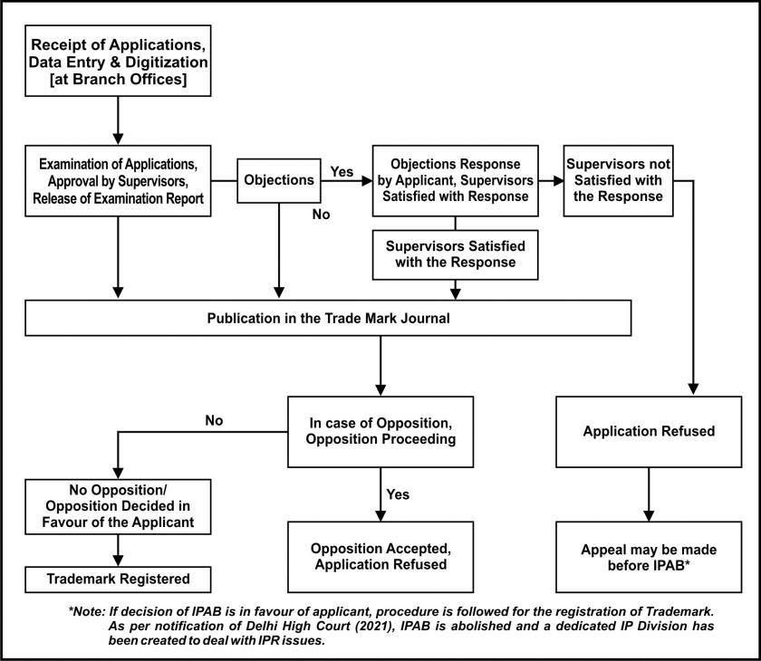
Flow chart for the process of Trademark Registration
One should keep in mind that while filing an application for the registration of a Trademark, an English translation of the non- English words has to be provided. If the applicant wishes to claim the priority from an earlier-filed application, he has to provide details like application number, filing date, country and goods/services of that application

Slide 17
Famous Case Law:
Coca-Cola Company vs. Bisleri International Pvt. Ltd.
‘MAAZA‘, a popular mango fruit drink in India, is a registered Trademark of an Indian company, Bisleri International Pvt. Ltd. The company transferred the rights (formulation, IPR and goodwill, etc.) to a beverage company, Coca-Cola, for the Indian Territory. However, in 2008, the Bisleri Company applied for registration of Trademark ‘Maaza‘ in Turkey and started exporting the product with the mark ‘MAAZA‘. This was unacceptable to the Coca-Cola Company and thus filed a petition for permanent injunction and damages for passing-off and infringement of the Trademark.
It was argued on behalf of Plaintiff (Coca-Cola Company) that as the mark ‘Maaza‘ concerning the Indian market was assigned to Coca-Cola, and manufacture of the product with such mark, whether for sale in India or for export, would be considered as an infringement. After hearing both the parties, the court finally granted an interim injunction against the defendant (Bisleri) from using the Trademark MAAZA in India as well as for the export market, which was held to be an infringement of Trademark.

Slide 18


